Slide 1
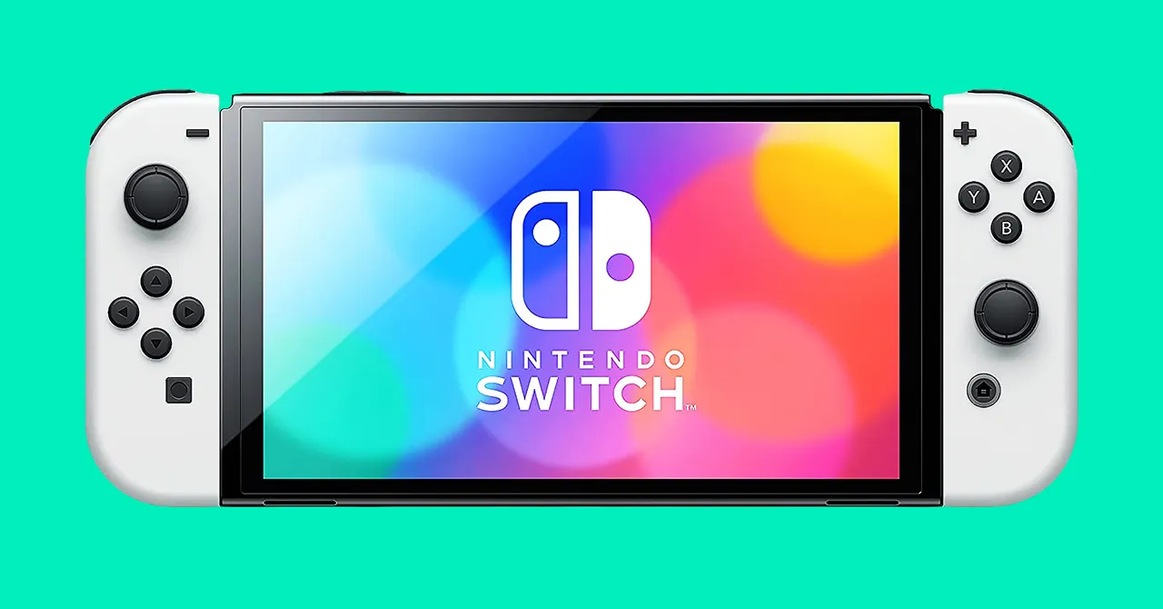
Let’s Flip the Switch!
Hamid Sutton, Terry Townsend, Brad Kivett

Slide 2
Target Areas for Redesign
Physical Appearance
Software Features
News
Theme Settings
Shop
New Implementations
Friends list
Messaging
Custom Themes
Power Settings

Slide 3
Issues with Target Areas
Physical Attributes
Screen is too small
Buttons are small
Controllers are hard to hold
System doesn’t fit well inside the Dock
Hidden SD card
Kickstand quality

Slide 4
Issues with Target Areas
Physical Attributes
Screen is too small
Buttons are small
Controllers are hard to hold
System doesn’t fit well inside the Dock
Hidden SD card
Kickstand quality
Software features
News and Shop
Search Bar
Organization
Theme Settings
Limited Theme Customization
Gallery
Power Settings
Only “Sleep Mode”

Slide 5
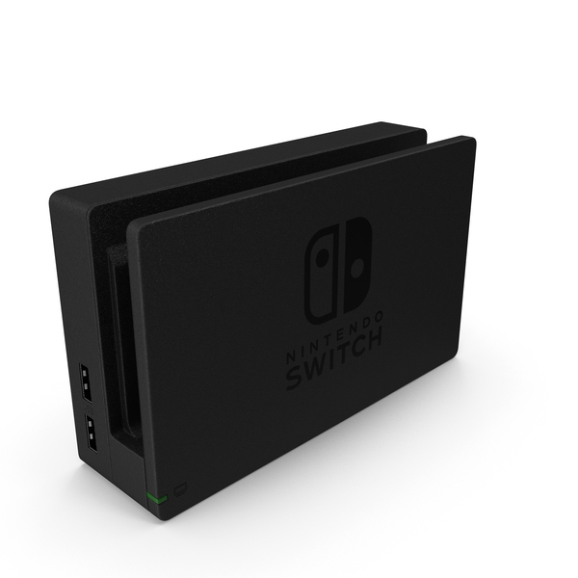
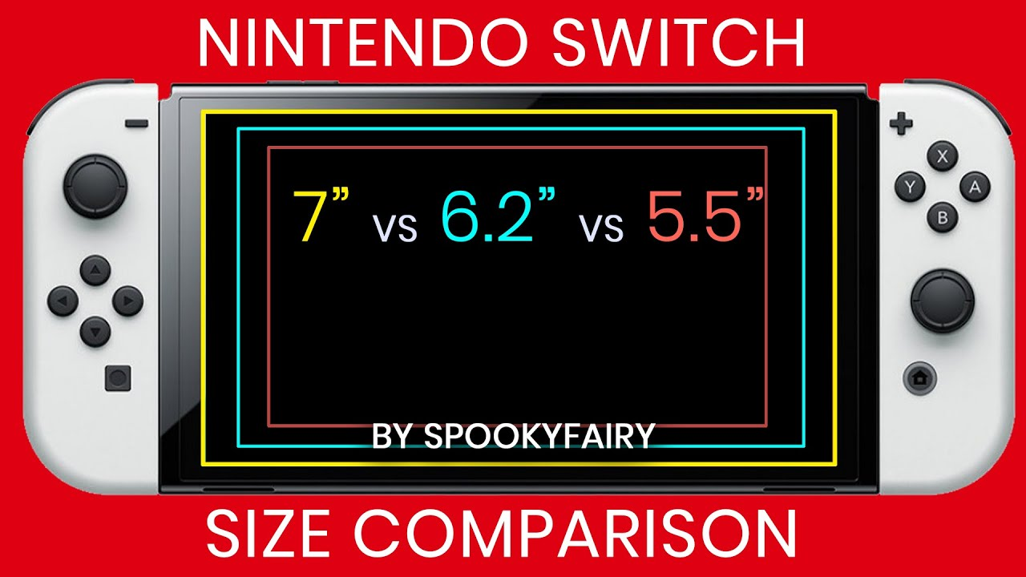
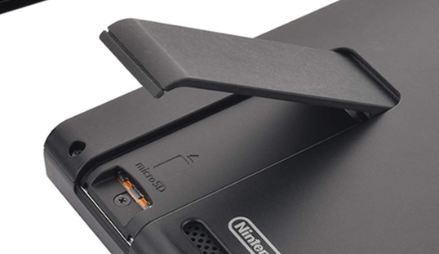
Issues with Physical Attributes
Tight fit may cause scratching
Flat design on controller
Hidden SD Card Slot

Slide 6
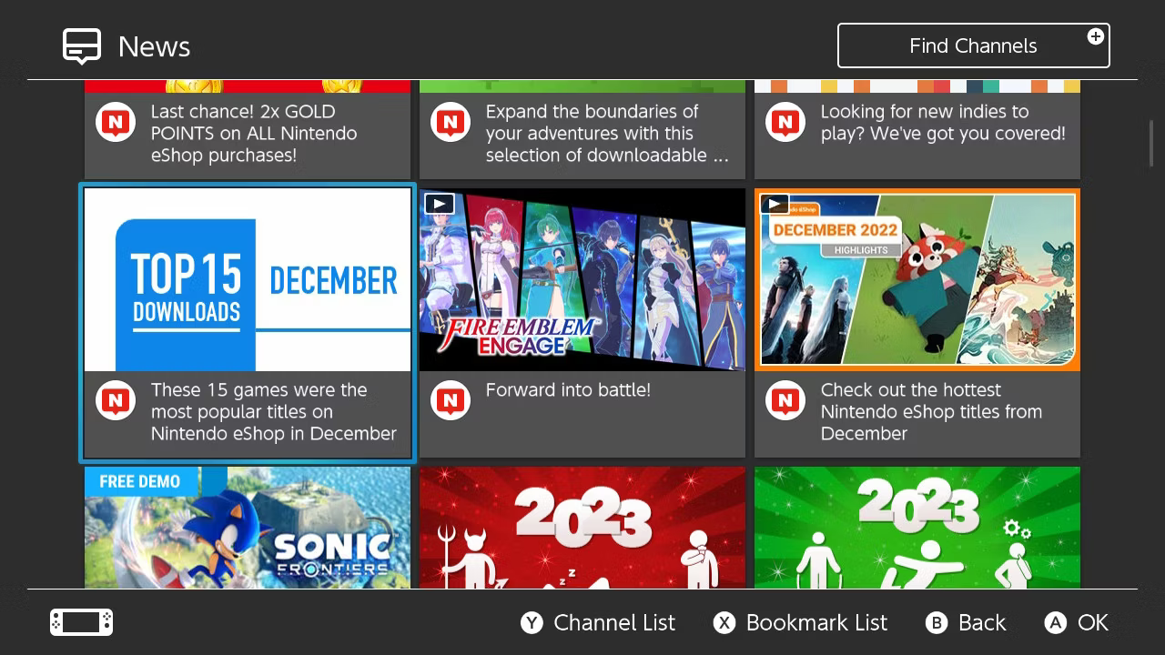
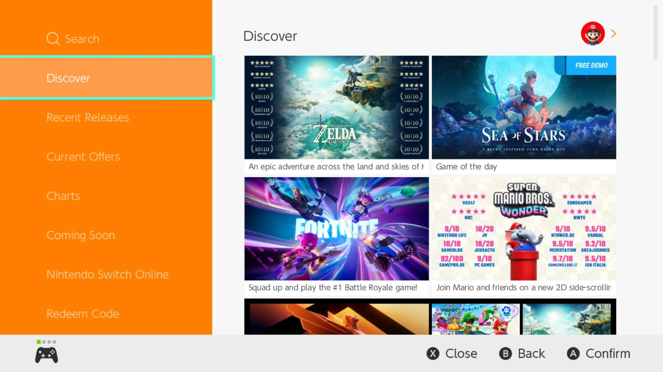
Issues with Software Features
News Page
eShop Page

Slide 7
Contextual Inquiry and Analysis

Slide 8
Representative Tasks
Turn on the console
Attach the remotes to the console
Change the theme of the device
Find “Pokemon Unite News”
Purchase “Super Mario Bros 3”
Play a game for 1-3 minutes
Prop the device like this (demonstrated)
Locate the memory card slot
Mirror the Switch to the TV
Power off the controllers

Slide 9

Do’s and Don'ts
Do’s
Make the joy-con and buttons larger
Add lighting to controls
Redesign the kickstand
Increase the size of switch
Improve the look of themes
Redesign the docking station
Change SD Slot location

Slide 10

Do’s and Don'ts
Do’s
Make the joy-con and buttons larger
Add lighting to controls
Redesign the kickstand
Increase the size of switch
Improve the look of themes
Redesign the docking station
Change SD Slot location
Don’ts
Change the game card size
Difficult to navigate
Make it difficult to open the kickstand
Non-user friendly design

Slide 11
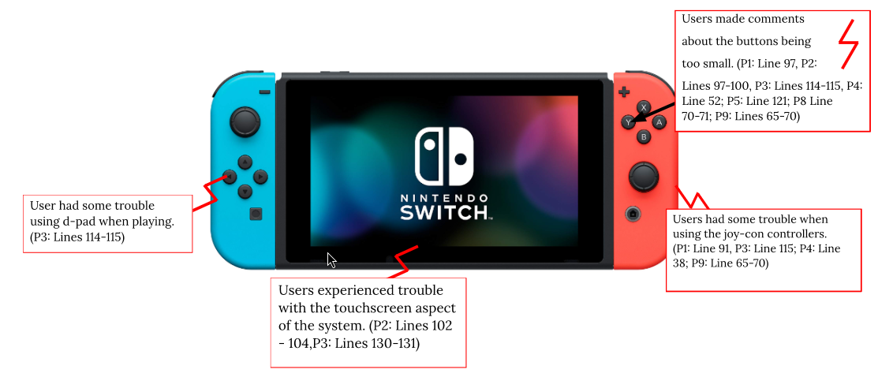
Artifact Model

Slide 12
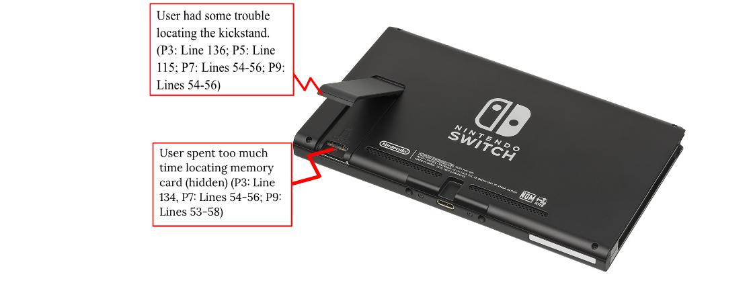
Artifact Model (Continued)

Slide 13
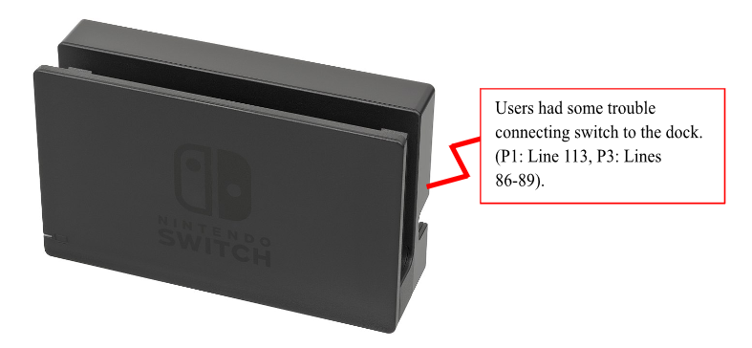
Artifact Model (Continued)

Slide 14
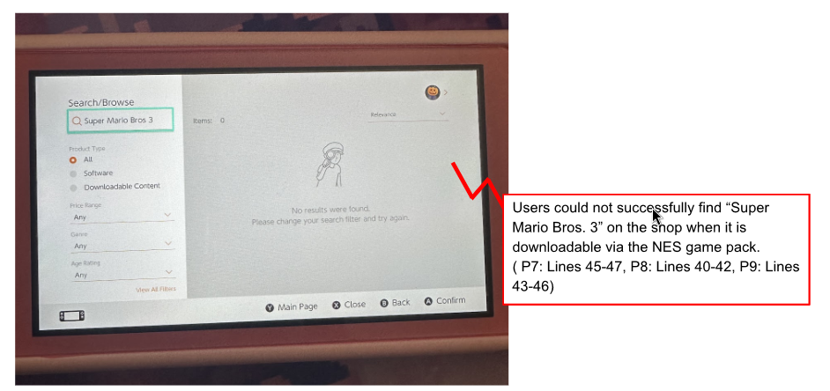
Artifact Model (Continued)

Slide 15
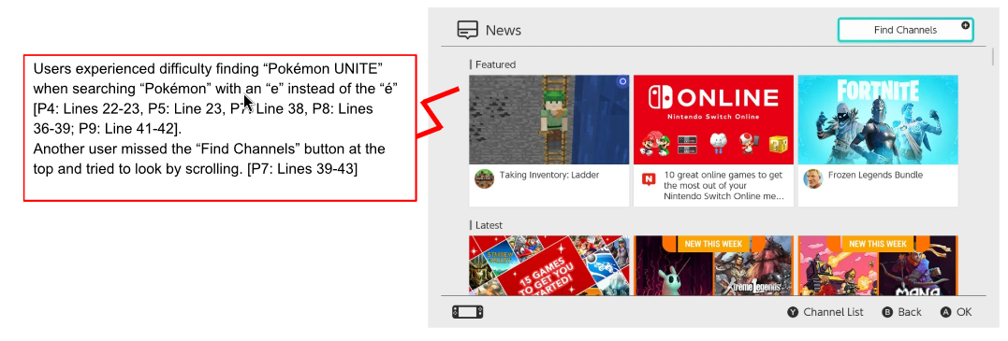
Artifact Model (Continued)

Slide 16
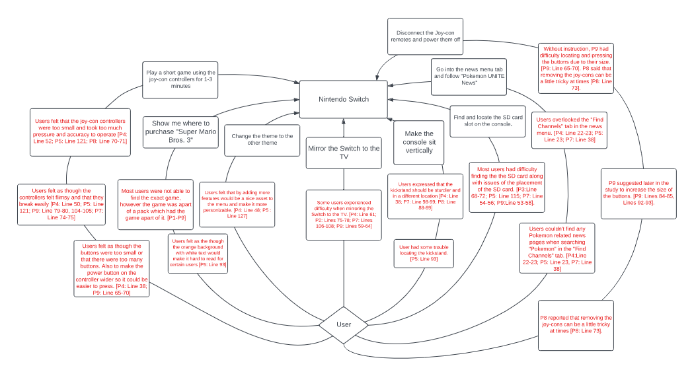
Flow Model

Slide 17
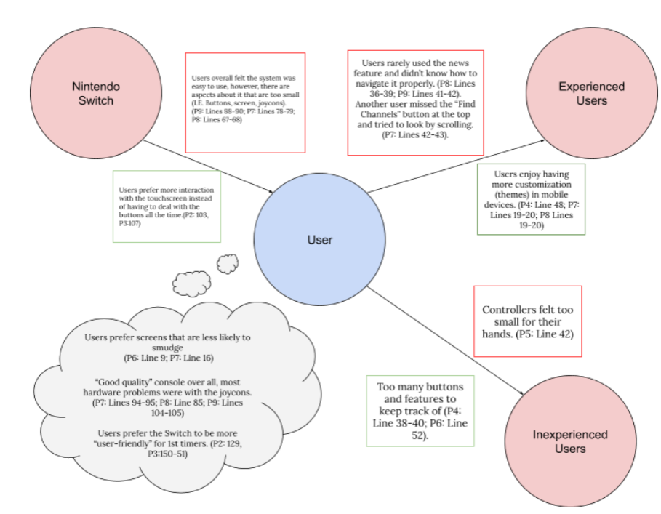
Social Model

Slide 18
Sketches & Final Paper Prototype

Slide 19
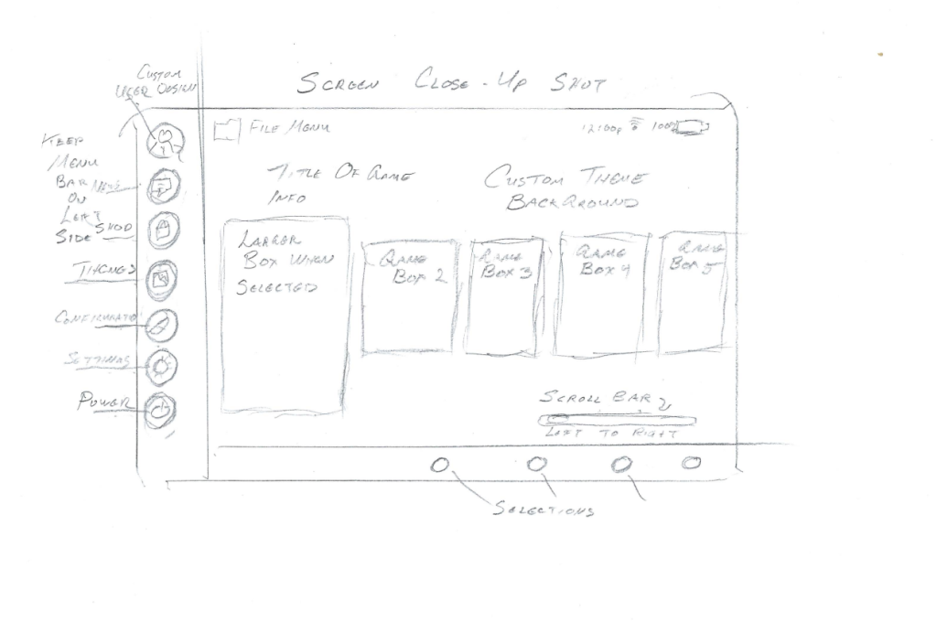
Sketches

Slide 20
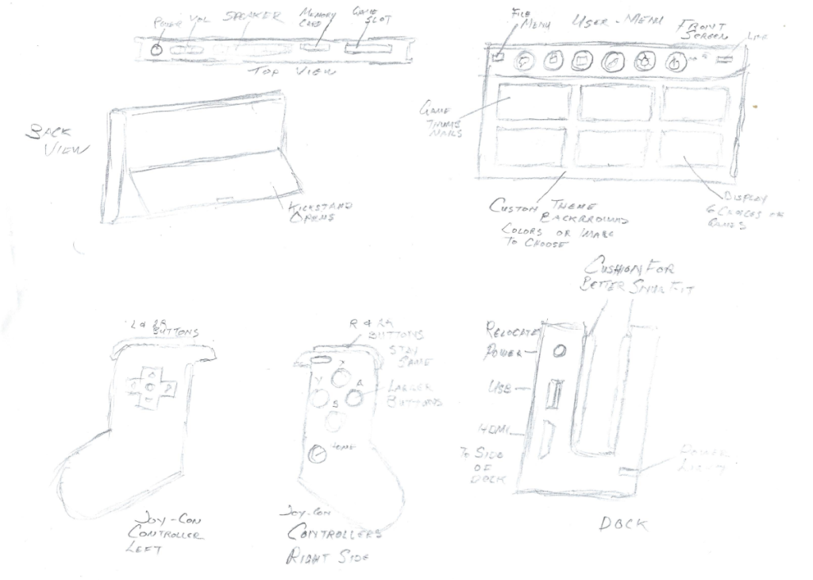
Sketches (Continued)

Slide 21
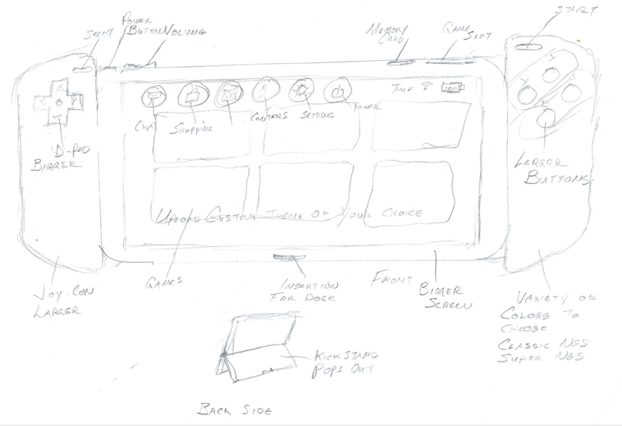
Sketches (Continued)

Slide 22
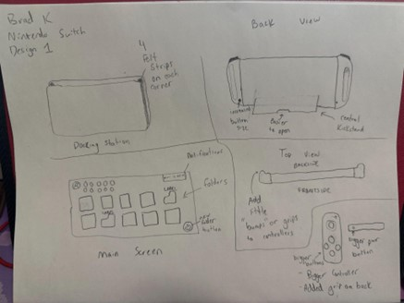
Sketches (Continued)

Slide 23
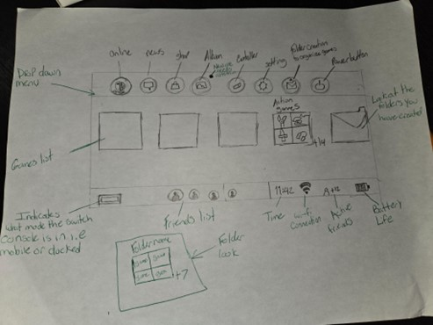
Sketches (Continued)

Slide 24
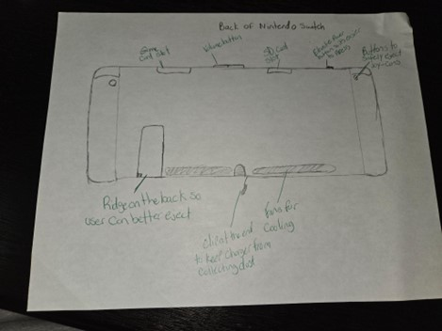
Sketches (Continued)

Slide 25
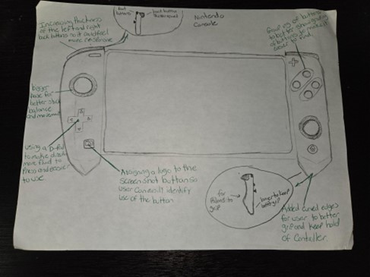
Sketches (Continued)

Slide 26
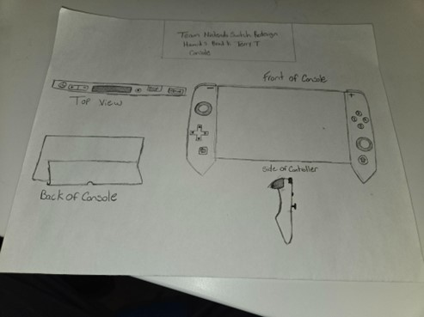
Final Paper Prototype (Hardware)

Slide 27
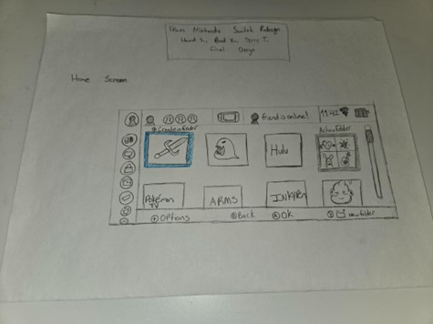
Final Paper Prototype (Software)

Slide 28
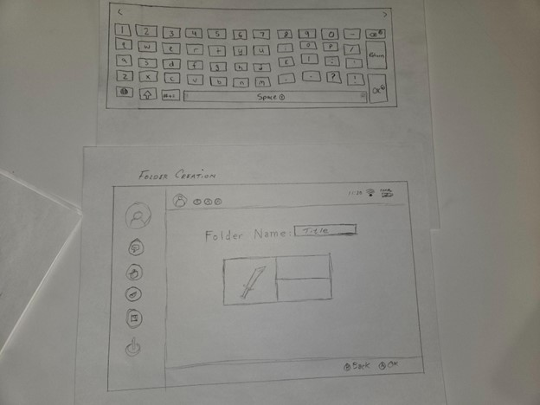
Final Paper Prototype (Software)

Slide 29
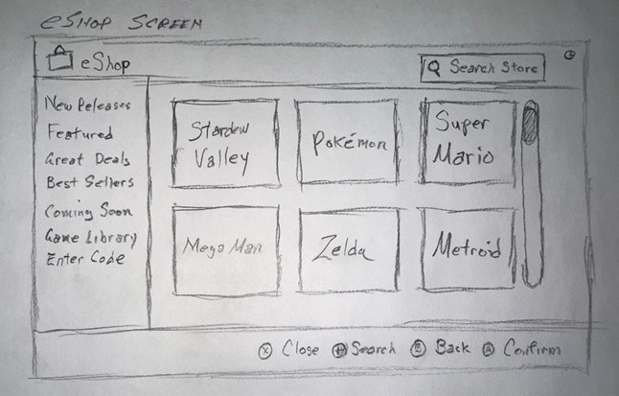
Final Paper Prototype (Software)

Slide 30
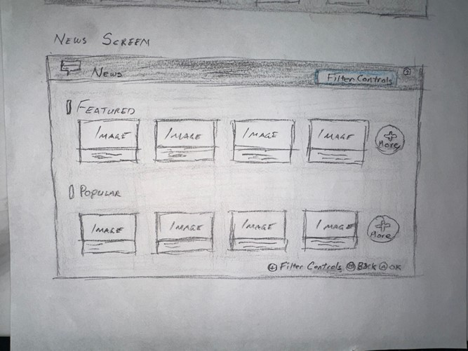
Final Paper Prototype (Software)

Slide 31
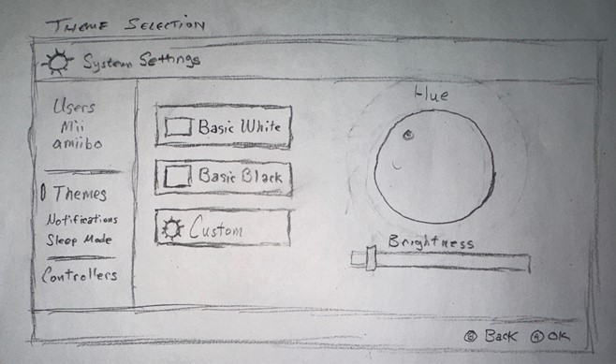
Final Paper Prototype (Software)

Slide 32
Storyboard

Slide 33
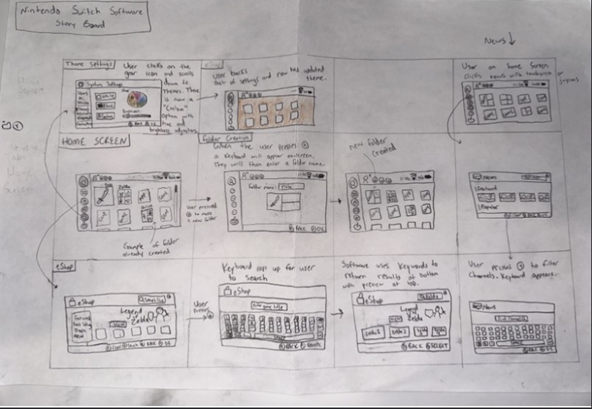
Storyboard

Slide 34
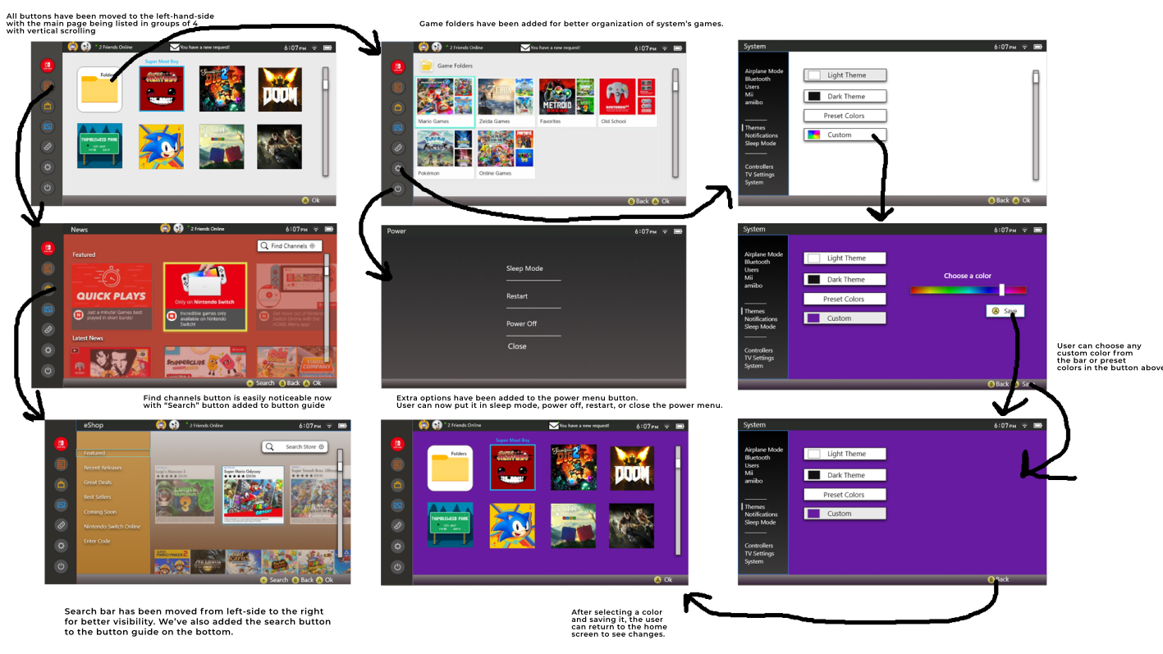
Storyboard

Slide 35
Usability Evaluation

Slide 36
Usability Evaluation
Icons should be bigger
Difficult to find how to create a folder
News button hard to identify
Rename “Filter Controls” to “Find Channels”
Difficulty using hue changer
Remove brightness slider for themes

Slide 37
Changes from Usability Evaluation
Bigger Icons
Clearer method for creating folders
Changed News Button Icon
Hover (not implemented)
Renamed search bar on News Page
Changed method of picking custom theme color
Removed brightness slider for custom themes

Slide 38
Working Prototype

Slide 39
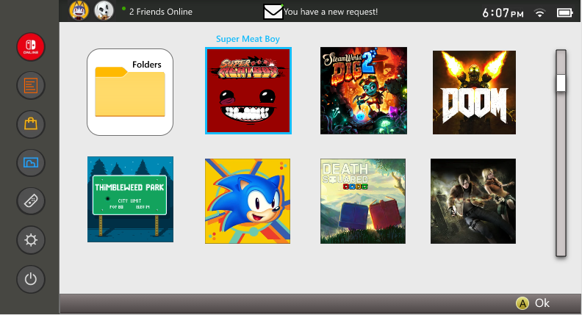
Working Prototype

Slide 40
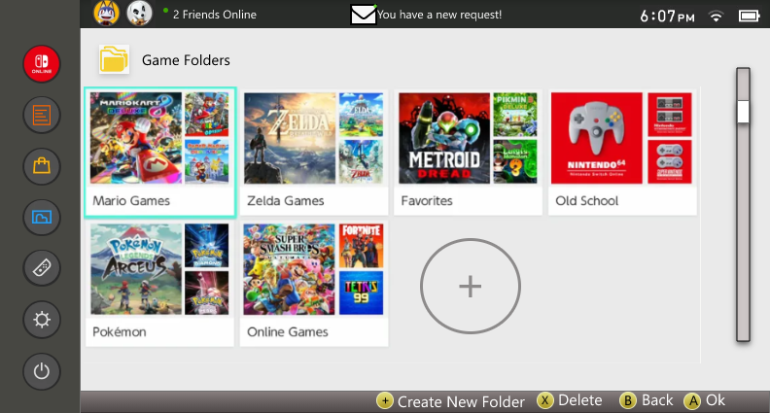
Working Prototype (Continued)

Slide 41
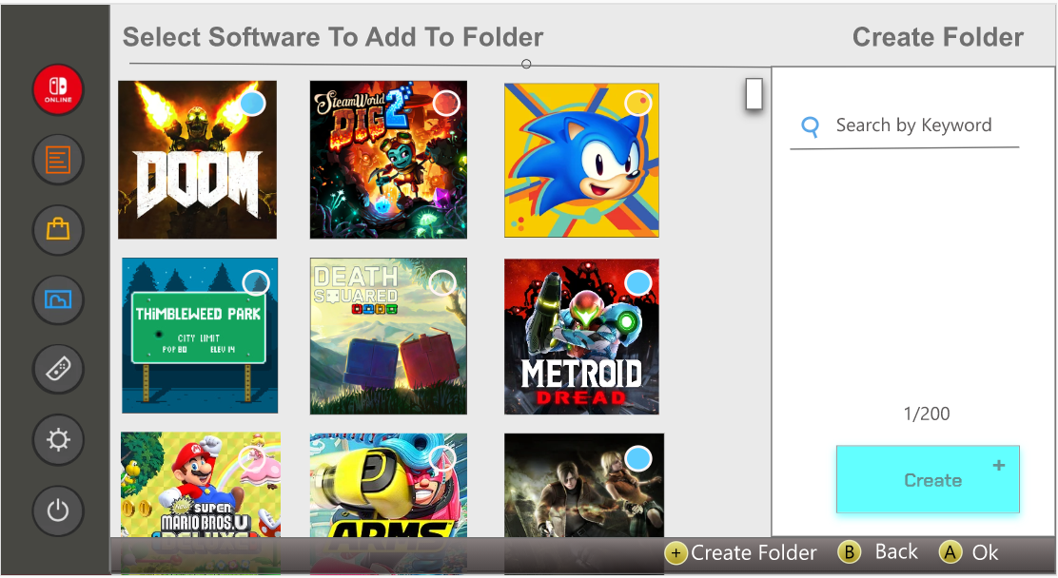
Working Prototype (Continued)

Slide 42
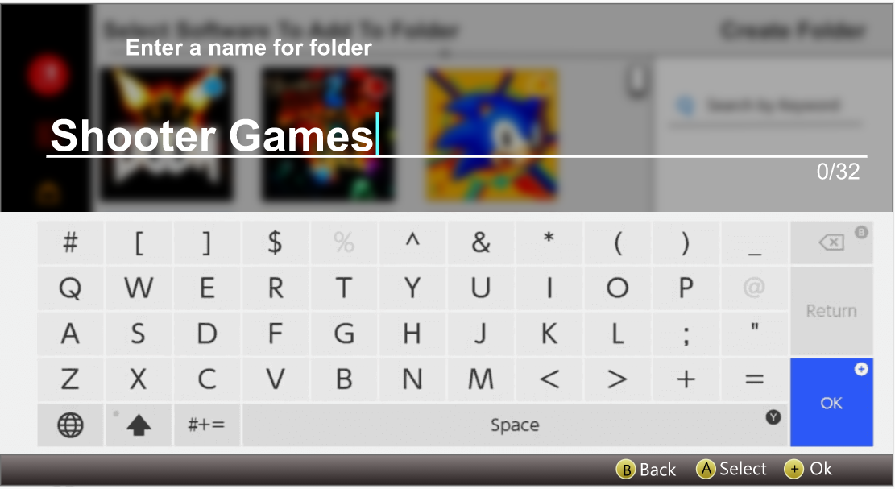
Working Prototype (Continued)

Slide 43
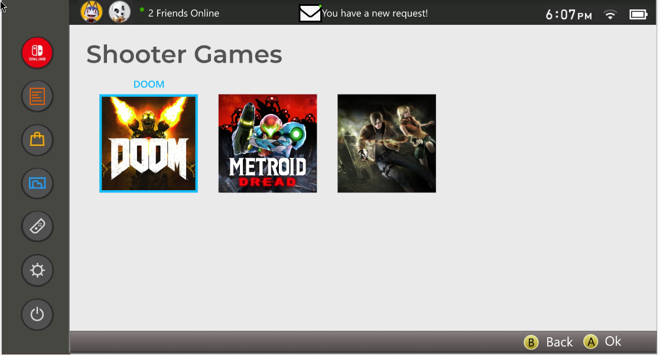
Working Prototype (Continued)

Slide 44
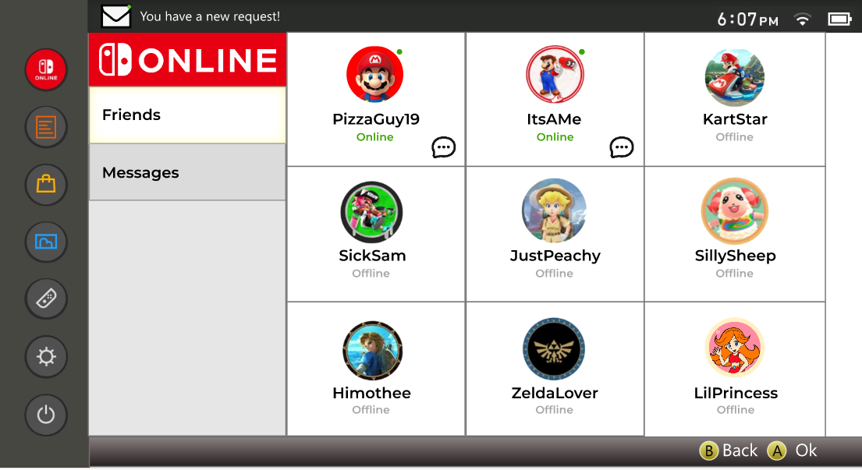
Working Prototype (Continued)

Slide 45
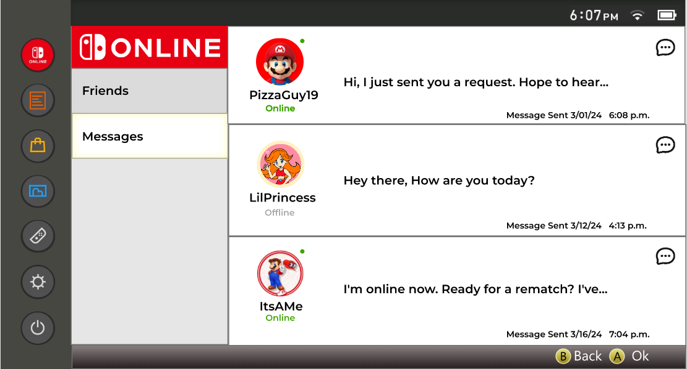
Working Prototype (Continued)

Slide 46
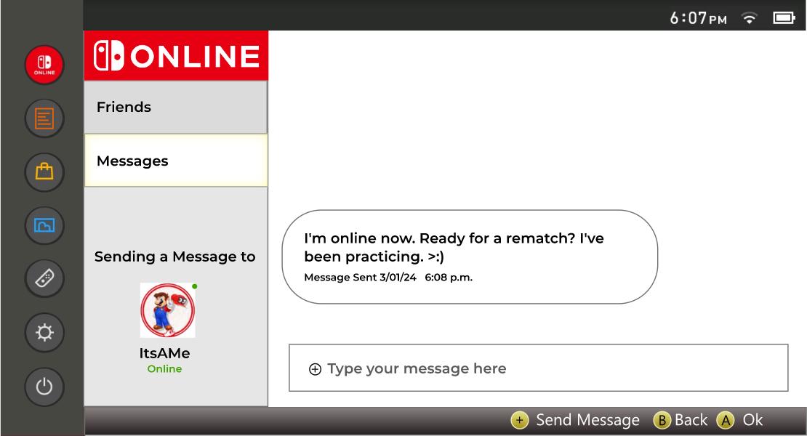
Working Prototype (Continued)

Slide 47
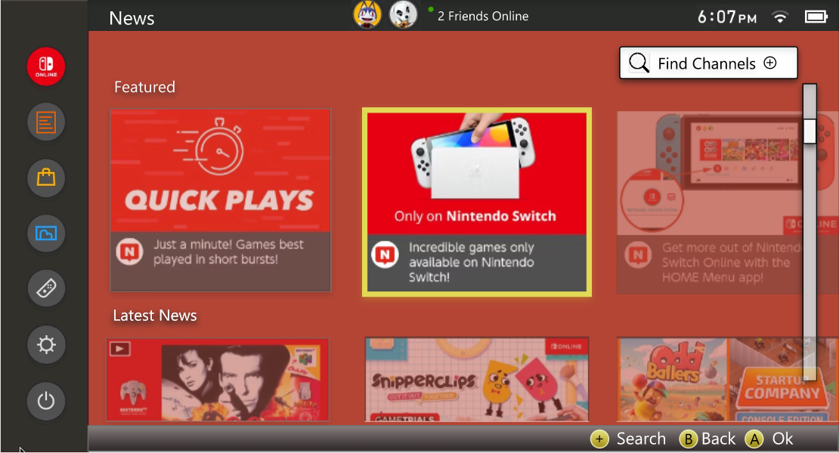
Working Prototype (Continued)

Slide 48
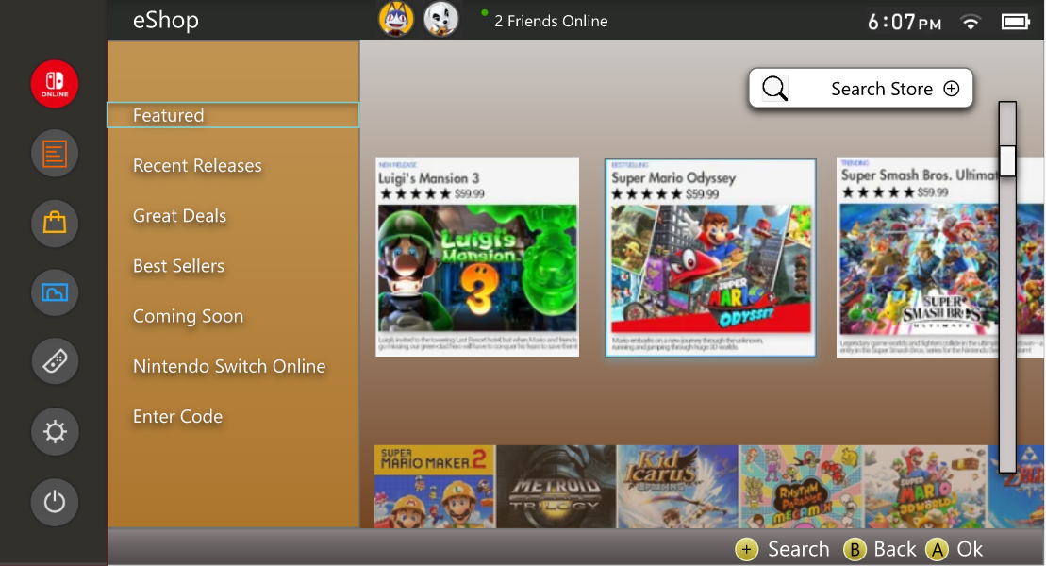
Working Prototype (Continued)

Slide 49
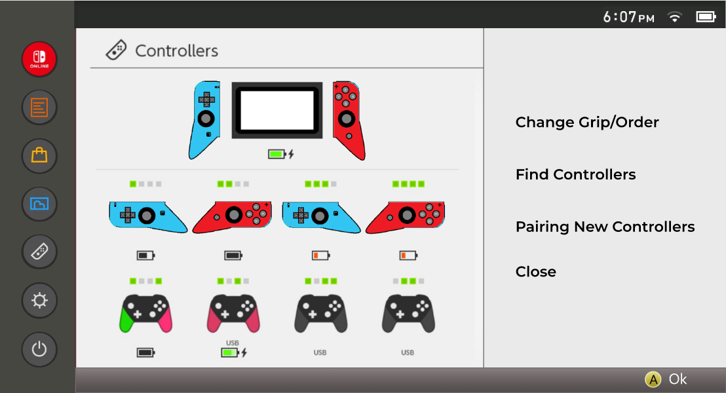
Working Prototype (Continued)

Slide 50
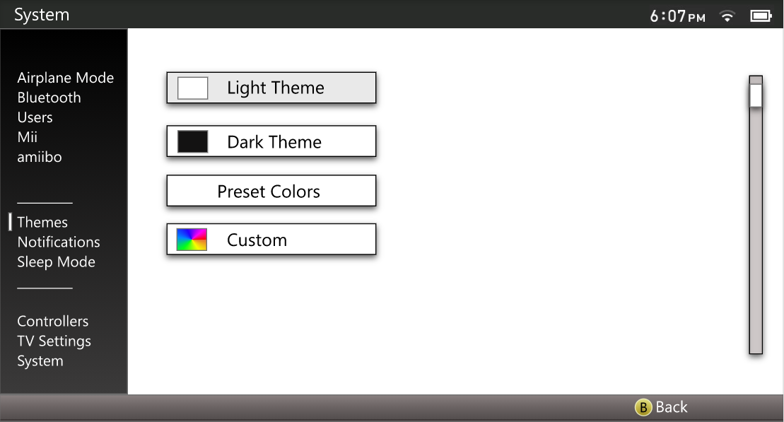
Working Prototype (Continued)

Slide 51
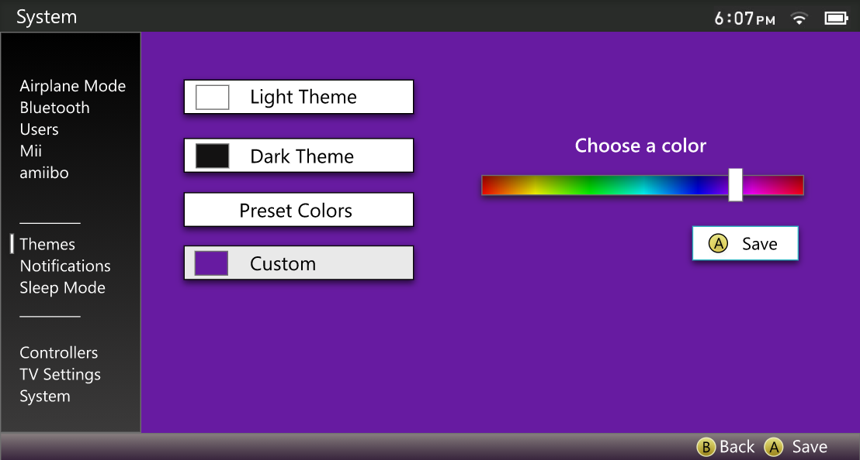
Working Prototype (Continued)

Slide 52
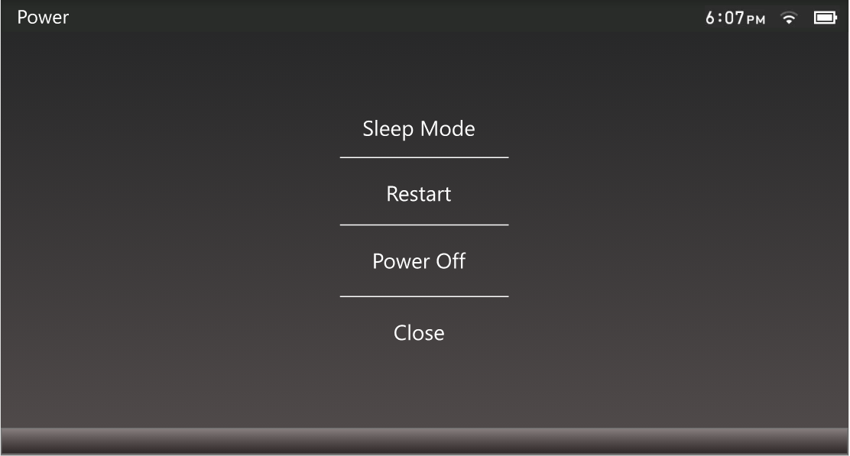
Working Prototype (Continued)

Slide 53
Heuristic Evaluation

Slide 54
Heuristic Evaluation
Evaluated by Team LinkedIn
Home menu button to got to home screen at any point
Cluttered settings menu
Sleep mode setting in the system settings tab
Comment icon in messages tab not being necessary
Folders tab in the home screen being out of place
Two search options on the shop page being unnecessary
Formatting issues with the back button

Slide 55
Heuristic Evaluation (Continued)
Two buttons to create a folder in game folders tab is unnecessary
Corresponding lights for 8 Controllers is confusing to understand
No indicator that user has changed the background color they have selected
Plus button in the search store bar in the e-shop menu
Consistency issues when trying to go back in the controller page
No sidebar in the settings menu
No button labels in power options screen
No option to add friends or accept or deny friend requests

Slide 56
Modifications and Justifications
We added a home screen option so user can use touch screen to go to home page at any time
We made more space between the options in the settings menu
We removed sleep mode option in settings menu
We removed the icon in the messages tab on the friends screen
We added a small icon in the corner of the home page to view game folders
We only made one search store option in e-shop menu
Tried our best to keep formatting with button labels consistent

Slide 57
Modifications and Justifications (Continued)
Removed the create folder button in line with the other folders
Limited the lights to just 4 controllers to make it easier to understand
Kept in consideration a save changes option but could not be implemented due to time constraints
Removed plus button in search store bar
Replaced the ‘ok’ button with a ‘back’ to go back to previous page in controllers menu
Decided to not add sidebar in settings menu to keep more space
Added button labels in power options menu
Made an add friends tab along with other tabs to fill space

Slide 58
Demo
https://xd.adobe.com/view/e1be7a75-d411-4544-8764-9ffa597284ca-b4ed/

